Slide 1

What Makes AdaBoost Different?
AdaBoost stands apart as a boosting algorithm that transforms its approach during training. Unlike static methods, it dynamically adjusts its focus based on performance, giving increasingly more attention to samples that prove challenging to classify correctly.
AdaBoost adapts while learning.

Slide 2
What Does "Adaptive" Mean Here?
The Core Principle
Key Insight
In AdaBoost, not all training samples carry equal weight. The algorithm actively tracks which samples are being misclassified and strategically increases their importance in subsequent training rounds.
Mistakes get extra attention-this is how the ensemble grows stronger with each iteration.
Each new model in the sequence receives a modified version of the training data where previously misclassified samples demand more attention-forcing the algorithm to learn from its mistakes.

Slide 3





How AdaBoost Learns Step by Step
Train a Weak Learner
Identify Mistakes
Start by training a simple model on the current version of the training data, where all samples initially have equal weight.
Evaluate the learner's predictions and carefully identify which training samples were misclassified.
Increase Importance
Train Next Learner
Boost the weights of misclassified samples, making them more influential in the next training round.
Train a new weak learner with the updated sample weights, forcing it to focus on previously difficult cases.
Each round learns from the previous one-this iterative refinement is what gives AdaBoost its adaptive power.

Slide 4
Sample Weights
Understanding the Intuition
Every Sample Has a Weight
Higher Weight Means More Importance
Misclassified Samples Get Higher Weights
Think of weights as volume controls for each training example. Initially, all samples start with equal weight, giving them equal influence.
When a sample's weight increases, the algorithm treats it as if it appeared multiple times in the dataset, forcing models to pay more attention to getting it right.
After each round, samples that were incorrectly predicted receive weight increases, while correctly classified samples may have their weights decreased.
Hard samples shout louder in the next round.

Slide 5
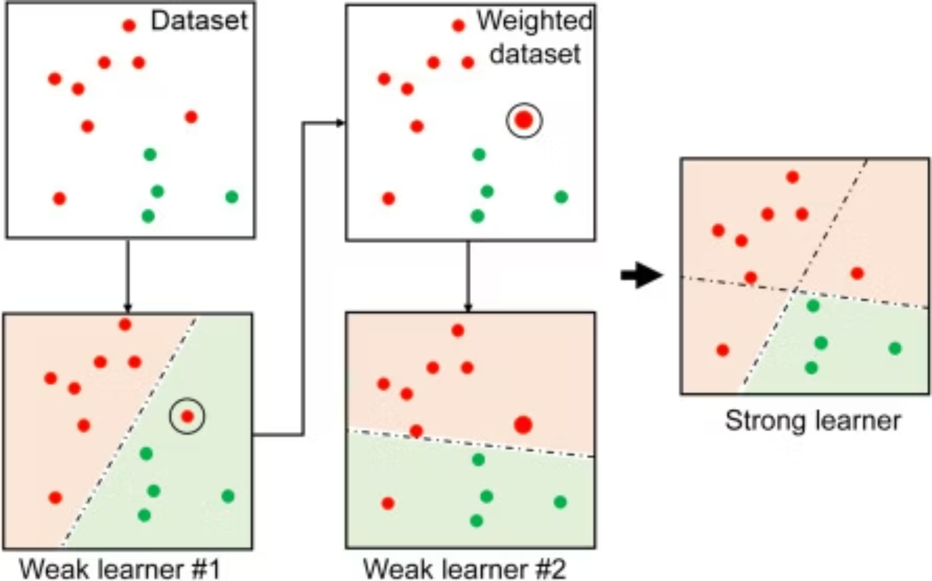
Building the Ensemble
This visualization illustrates the AdaBoost process in action. It starts with an initial dataset, which is used to train Weak Learner #1. The dataset is then reweighted, emphasizing misclassified samples (notice the circled misclassified point gets more emphasis), before training Weak Learner #2 on this adjusted data. This iterative process continues, with each weak learner focusing on the mistakes of its predecessors. Finally, these weak learners are combined into a strong learner, leading to better overall predictions.

Slide 6
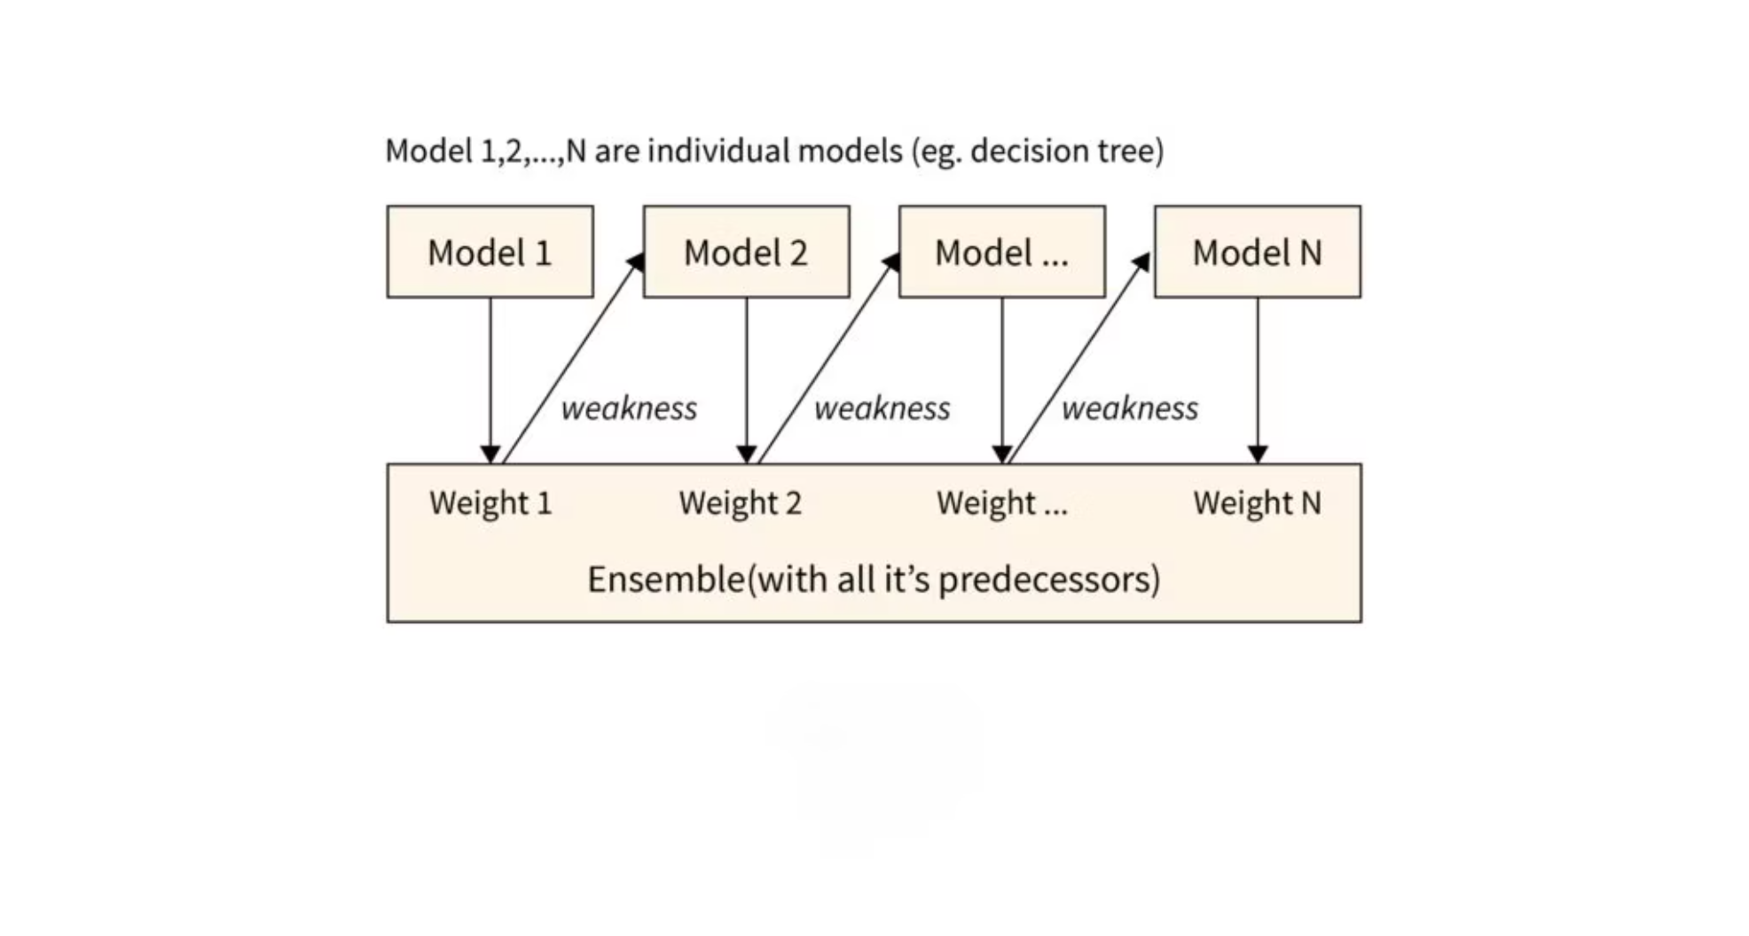
Weighted Voting
How Final Predictions Are Made
Not All Votes Are Equal
When making a final prediction, AdaBoost doesn't simply count votes from each weak learner. Instead, it uses a weighted voting system where more accurate learners have greater influence on the outcome.
Each weak learner receives a voting weight based on its training accuracy. Models that perform better on their respective weighted datasets earn higher voting power in the final ensemble decision.
Final prediction is a weighted vote, not a simple vote.

Slide 7

Common Misconceptions
Setting the Record Straight
❌ Weak Learners Are Useless
❌ More Learners Always Means Better
❌ AdaBoost Equals Random Forest
Reality: Weak learners are strategically simple, not ineffective. They provide focused improvements that combine into powerful predictions when properly weighted and sequenced.
Reality: Beyond a certain point, adding more weak learners provides diminishing returns and can lead to overfitting. The optimal number depends on your specific problem and data.
Reality: Random Forest trains trees independently in parallel with bagging. AdaBoost trains learners sequentially, with each one influenced by previous mistakes-fundamentally different approaches.
Misunderstanding these concepts leads to misuse. Understanding the differences helps you choose the right algorithm for your problem.

Slide 8
Quick Concept Check
Test Your Understanding
Question 1
Question 2
Question 3
Does AdaBoost treat all samples equally throughout training?
Does AdaBoost train its learners independently of each other?
Why shouldn't we use very deep trees as weak learners in AdaBoost?
Think about: sample weights and how they change
Think about: sequential training and weight updates
Think about: overfitting risk and the purpose of weak learners
If these questions make sense, you're ready for the math-lite part. You now understand the core intuitions behind AdaBoost's adaptive learning strategy.

